Slide 1


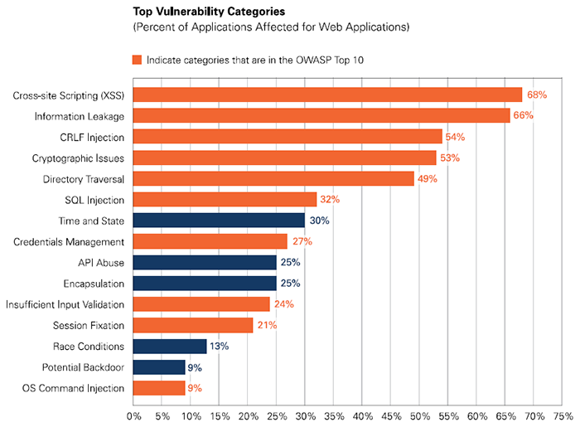
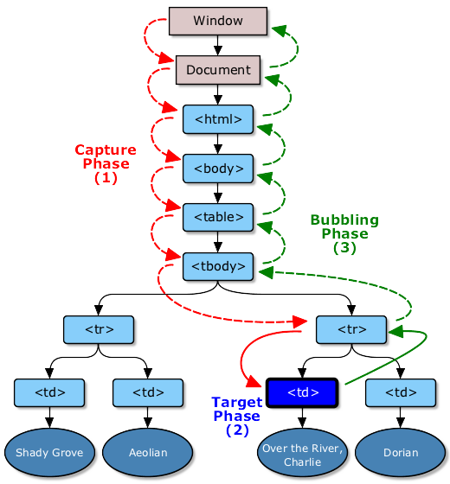
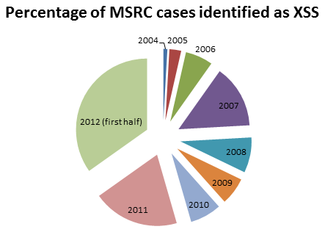
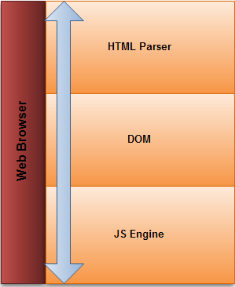
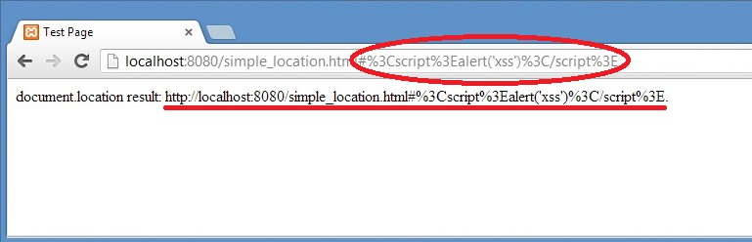

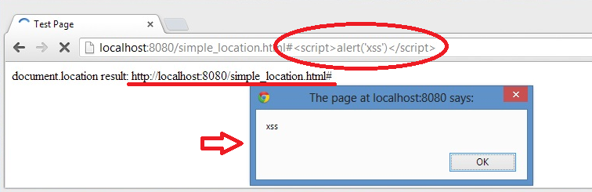

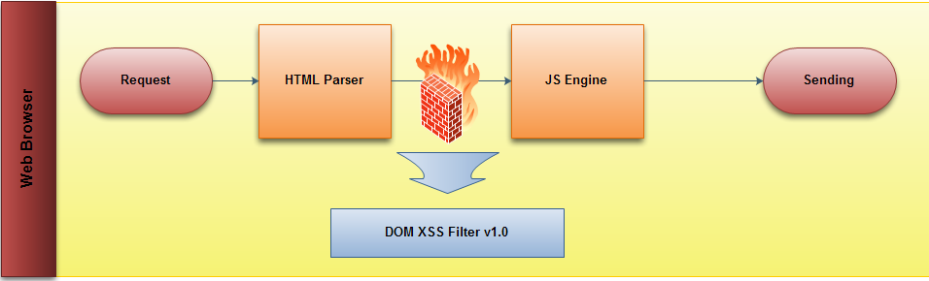
DOM-Base XSS Filter
Heryandi Lu Fangjian Yang Yuhang Yang Zhaoyu
School of Computing, National University of Singapore
Web Apps Trends
Approach Overview
Implementation
Browser: Chrome Version 26.0.1410.43 m
JavaScript
Chrome Extension API
Result
DOM-Base XSS is different from
stored XSS and reflected XSS
Attack entirely within the browser as depending
on server response.
Evaluation
Effectiveness
/cs#default=<script>alert(document.location)</script>
/cs?default=<script>alert(document.location)</script>
/simple.html#default=<script>alert(document.location)</script>
/simple.html?default=<script>alert(document.location)</script>
Compatibility
Well working with access below websites but
not limited
https://www.google.com/ https://mail.google.com
https://www.facebook.com/ https://twitter.com/
http://www.wikipedia.org/ http://slashdot.org/
https://news.ycombinator.com/ http://www.yahoo.com/
http://www.youtube.com/ http://www.amazon.com/
Our Solution:
#Rule 1: Overide document.URL getter:dangerous code in url such as?<script>...
#Rule 2: Overide document.URLUnencoded: Other entry possibly inject code.
#Rule 3: Overide document.location via encoding location.hash.
(document.location.search already supported by google.)
Rule 4: Encode the value of window.location.hash.
Goal
Intercepting and handling effectively without
making effect on user experience.
Efficiency: No significant overhead
Flexibility: Ease to maintain
Compatibility: Without serious effect
Applicability: The new from others
Future Work

